Slide 1
9B59B6 DF4461
2C3E50
F3E4DA

Slide 3
SmartER Speaker
: Speaker-Adaptive Voice Assistant
Team Members
Ken Lee Nick Ki Gumann
Jin Seo Hong
Patrick Segedi
Tae Hee Kim
: AI Developer : Backend Developer
: Frontend Developer
: Pipeline Developer
: Project Manager, UI/UX Designer

Slide 4
Contents
서비스 소개
아키텍쳐 구성
데모 영상 시연
향후 논의
01
Service Overview
04
AI Model: SpeechBrain
02
Implementations
05
Future Implementations
03
Systeme Architecture

Slide 5
01
Service Overview

Slide 6


Slide 7
01
Service Overview
Our goal is to create a voice assistant
that genuinely understands you.
Speaker Authentication – Wake word that recognizes different user
Intelligent Command Processing – Gemini AI – Smarter response
Smart Home Device Control – FastAPI + MySQL server control
Personalized Movie Search + Age Restriction

Slide 8
02
Implementations

Slide 9
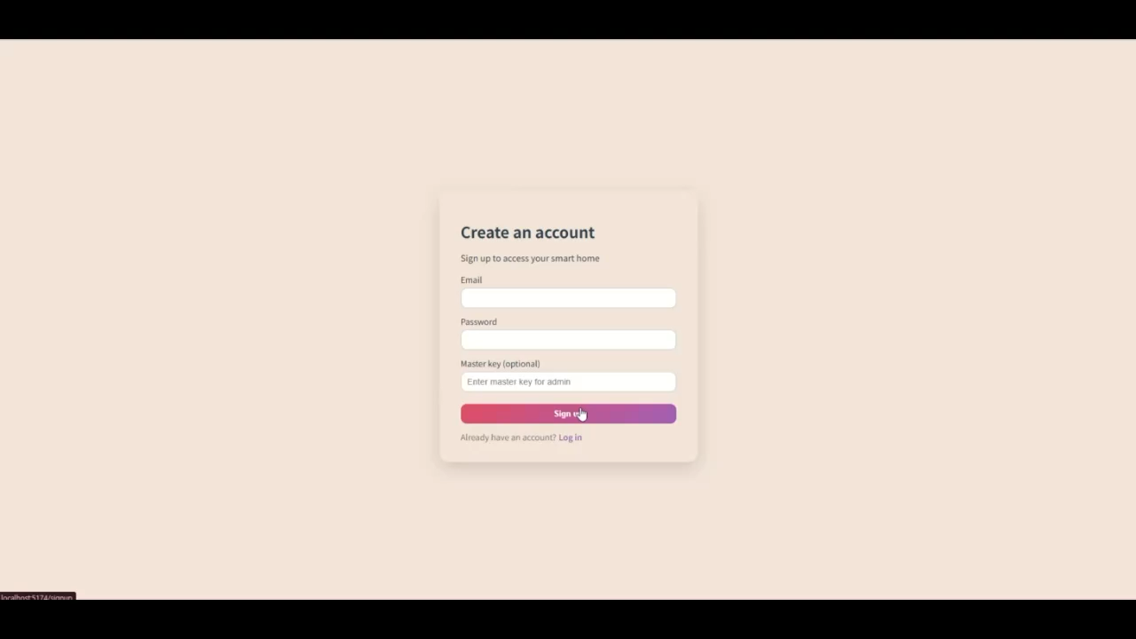

Slide 10
02-1
Implementations
1. Voice Recognition & Speaker Authentication
SpeechBrain ECAPA-TDNN model
After wake word, it responses.
2. Speech-to-Text & Command Interpretation
Recorded audio is converted into text using the custom AudioToText module.
The recognized sentence is processed by Gemini AI,
which extracts the intent, entities, and required action.
3. FastAPI Backend & MySQL Database Integration
The backend uses SQLAlchemy ORM to manage a MySQL database
Provides REST endpoints

Slide 11
02-2
Implementations
4. React Web Dashboard (Smart Home UI)
Built with React + Vite for fast SPA development
Allows users to view and toggle IOT devices
5. Movie Search & Age Restriction System
The AI speaker can search for movies using voice commands.
The backend compares the user’s age with the movie’s ageRating.
6. IoT Hardware Integration–Ready Architecture
The FastAPI route /devices/{id} is designed to support actual IoT hardware.
Currently, software-level simulations are fully functional.

Slide 12
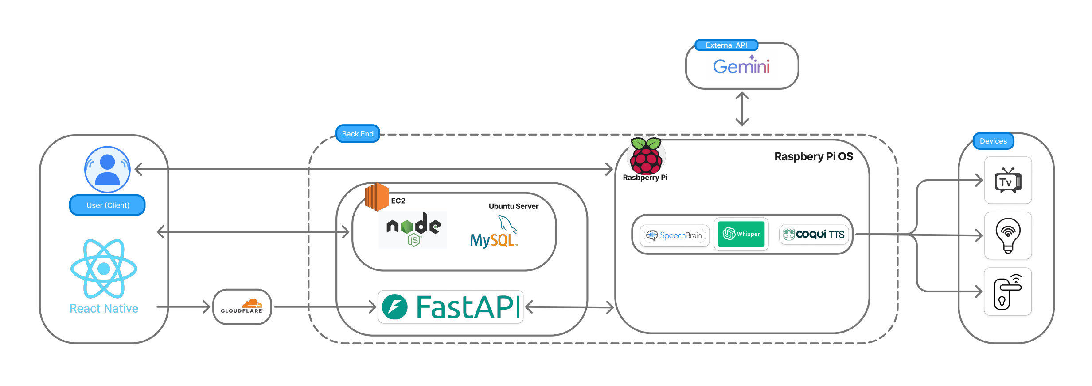
03
System Architecture

Slide 13
04
AI Model: SpeechBrain
Smart Speaker System's Speaker Authentication System utilizing SpeechBrain ECAPA-TDNN Model
ECAPA-TDNN is a speaker recognition model pre-trained on the VoxCeleb dataset.
Through its Channel Attention mechanism, it focuses on important speech features and provides real-time speaker authentication with high accuracy without requiring additional training.
User | Registered embedding | Cosine similarity | Rank
Ken | [0.15, -0.31, 0.72, ..., 0.48] | 0.847 | 1
Patrick | [0.08, -0.45, 0.51, ..., 0.52] | 0.312 | 3
Nick | [0.21, -0.28, 0.43, ..., 0.39] | 0.287 | 4
Jinseo | [-0.03, -0.52, 0.68, ..., 0.41] | 0.451 | 2
Taehee | [-0.23, -0.72, 0.36, ..., 0.21] | 0.182 | 5
Item | Value
Input audio length | 2.3 seconds
Extracted embedding | [0.12, -0.34, 0.67, ..., 0.45] (192 dimensions)

Slide 14
05
Future Expectations
Personalized Calander
The speaker, after recognizing the user, will be able to register the user in the database. The user will be able to know what their schedule is, just using their voice.
Temperature Control
The user can set the temperature for air conditioning and heating in the house. The speaker will be able to save the preferred temperature for each user.
Execution of Multiple Tasks through a single command
For example, if the user says, “Help me focus on studying.”, the speaker will set the perfect light personalized for the user and turn their favorite studying playlist on to help them focus.
Notes:
Multicommand = «Hey Speaker I want to study» -> Chooses Users Study Playlist and sets the right light settings in the room

Slide 15
Thank you.

